Slide 1
The Massachusetts Toxics Use Reduction Act (TURA): Services for Businesses and Communities September 12, 2017
Felice Kincannon
felicek@turi.org
Notes:
Mike: Introduce yourself and explain that this presentation is going to provide an overview of TURA program services. Encourage them to share information about our services with their constituents, and to let us know what they’re hearing about constituents’ needs.

Slide 2
Core principles of Toxics Use Reduction
Reduce toxics at the Source
Look for opportunities to eliminate or reduce hazard
Primary prevention of disease
Source Reduction
Treatment
Disposal
Recycling
Notes:
The TURA program helps companies reduce toxics at the source. The benefit of this is that if you don’t use the toxic to begin with, then you don’t need to recycle, treat it, or dispose of it. And you reduce any health and safety effects from the start.

Slide 3
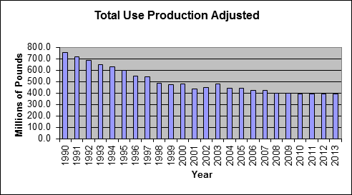
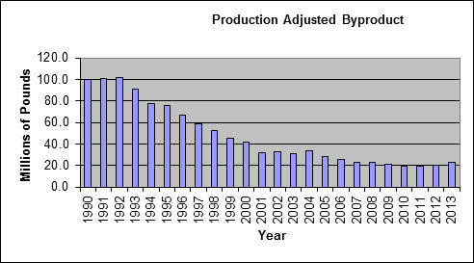
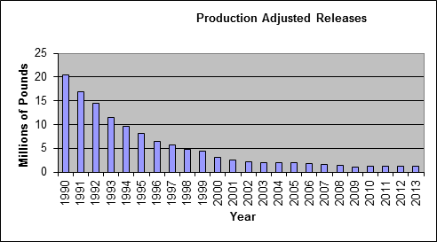
How TURA Works
48%
Users of large amounts of toxic chemicals must:
Report toxics use
Pay fees
Funds support services to industry & communities
Plan toxics reduction
77%
91%
Notes:
Mike:
Reporting: Explain the importance of USE REPORTING, rather than just reporting on releases (provides additional information on how the facility works, helps identify hazards for workers, facilitates planning to reduce toxics from the start)
Fee: Explain this fee is what funds the program services.
Planning: Mention/explain the role of TUR planners.
However, companies DO NOT HAVE TO reduce toxic chemical use if it doesn’t make economic sense. Companies choose whether or not they make the reductions. The data how that companies have reduced.
Reporting – About use, not just emissions.
Fees – Funds support services.
Planning – businesses look at how they are using chemicals and see where they could shift.
Data show…
Add emissions chart; 91 percent decline/downward pointing arrow.

Slide 4
Toxics Use Reduction Planning
Companies assess:
How and why toxics are used
Changes to production processes that could reduce use or waste and associated costs and savings
Whether it makes business sense to implement changes and whether company chooses to do so
Plans must be approved by a licensed Toxics Use Reduction Planner
Notes:
The law established TURI and the Office of Technical Assistance. We work with MassDEP to implement the law.

Slide 5
Reporting
Annual reports on amounts used, wasted, shipped in product, released onsite, or shipped offsite as pollution
Affects ≈ 500 companies with 10 or more FTEs
Makes companies aware of quantities they use and waste
Notes:
TURA was passed into Massachusetts law in 1989. Recently celebrated 25 years by honoring companies for their significant accomplishments in reducing τοξιχσ and conserving resources.

Slide 6
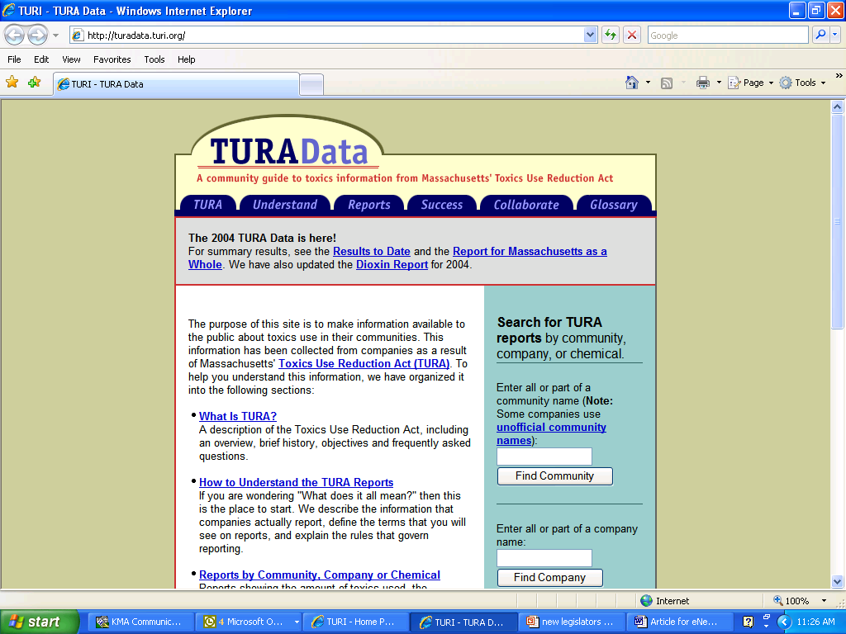
Using the TURA Data Online
Enter your city or town or search by chemical
turadata.turi.org

Slide 8
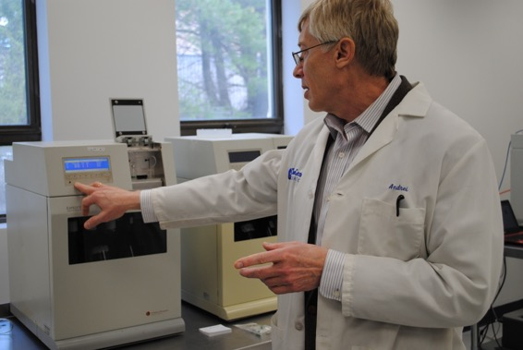
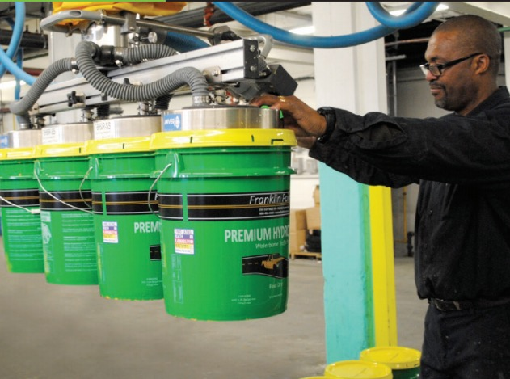
TURI Resources & Activities
Education & training
Grants
Large & small businesses
Municipalities, regional governments & community organizations
University research on safer alternatives
Demonstration sites
Laboratory & library services
Facilitated work groups for
industry sectors
Policy analysis
Notes:
Re: policy, mention that if they would like to learn about current developments at the federal level (TSCA reform), they can check with Rachel

Slide 9
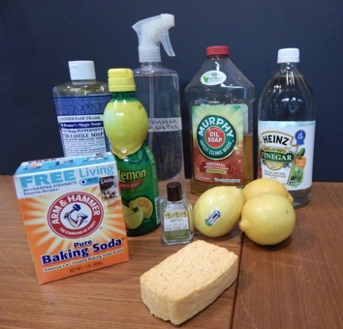
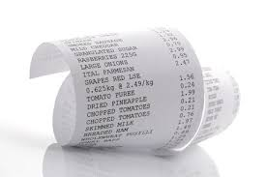
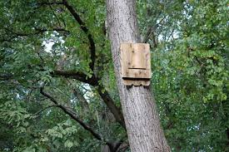
Community Grants Program
FY17 Grants -examples
Providing safer household cleaners in bodegas
Educating workers and consumers about BPA exposure in cash register receipts
Delivering green building educational programs for architects, developers, and homeowners
Notes:
Joy summarizes grants, why we award the grants (goal of comm grant program), example of the type of activities organizations do.
Our grant deadline is typically the end of June so be sure to let any organizations in your district know about the grants.

Slide 10
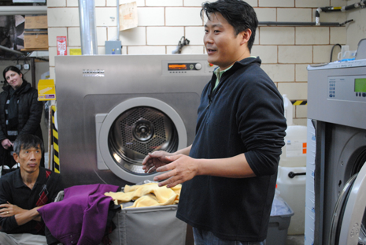
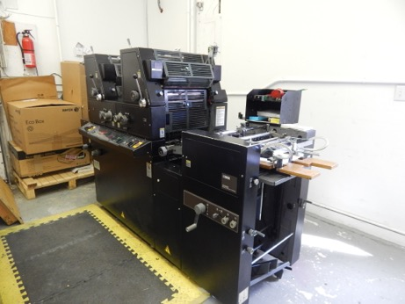
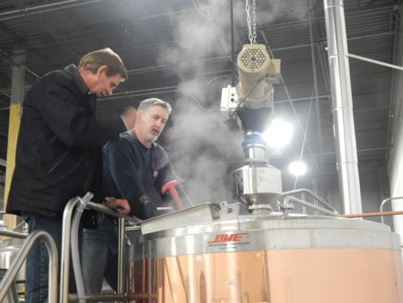
Business Grants Program
FY17 Small Business Grants
Eliminating perchloroethylene in dry cleaning
Replacing caustic sodium hydroxide and acids used for cleaning in breweries
Eliminating of solvents in printing operations
Replacing flame retardant laden foam pit cubes in gyms

Slide 11
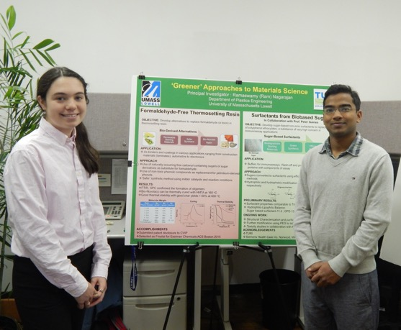
Current Academic Research Grant Projects: UMass Faculty Partnering With Mass. Companies
Siemens Healthineers, Norwood: evaluation of sugar-based surfactants as alternatives to octylphenol ethoxylates for medical devices
Camco, Leominster: identification of alternatives to methanol for windshield washer formulations
ITW Polymer Sealants, Rockland: research for safer solvents in contact adhesives
MD Stetson, Randolph: the effectiveness of cleaning versus disinfection
www.turi.org/research
Notes:
Safer oligosaccharide-based surfactants as an alternative to octylphenol ethoxylates in medical device applications
Partnership with Siemens Healthcare Diagnostics
Lower toxicity solvents for contact adhesives
Partnership with ITW Polymers Sealants
Safer alternatives to methylene chloride paint strippers for consumer use
Partnership with Savogran

Slide 12
Related Examples
Cape Cod First Responders
Westford Water Department
Perchlorate in
emergency flares
Pesticides in
groundwater

Slide 13
Call for Proposals: FY19 Grants
Industry Grants: up to $30,000 and intended for manufacturing facilities to improve processes or install technology that results in reducing toxics.
Small Business Grants: up to $10,000 and intended for businesses that provide services directly to consumers. For example, dry cleaners, restaurants, auto repair and tire shops, bathtub refinishers, etc.
Community Grants: up to $20,000 available for regional or statewide projects and up to $10,000 for local projects. Municipal governments, environmental and community organizations, youth organizations, housing authorities and school districts are all eligible to apply.
Academic Research Grants: up to $25,000 and available to UMass faculty and their graduate students to partner with Massachusetts companies on researching safer alternatives to toxic chemicals.

Slide 14
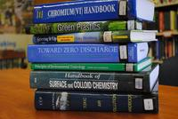
Other TURI Resources
Library
Specialized collection of books, articles and databases
Contact our library manager with your individual questions
Beyond the MSDS
Workshop October 2 – register at www.turi.org
Recorded webinar at www.turi.org
Notes:
Switch to Rachel here

Slide 15
Contact us with any questions!
TURI: www.turi.org
Sign up for our Newsletter
Sign up for Greenlist Bulletin
Follow us on Facebook
TURI: Felice Kincannon
felicek@turi.org

