Slide 1
Ota Resources &
Climate Change Preparedness
Tiffany Skogstrom, MPH
Outreach & Policy, Massachusetts Office of Technical Assistance (OTA)
tiffany.skogstrom@state.ma.us, 617-626-1086
@Mass_OTA

Slide 2
Massachusetts Office of Technical Assistance (ota)
Toxics Use Reduction Act (TURA) of 1989
Three partnering agencies:
MassDEP (Regulatory)
TURI (Research & Grants)
OTA (Technical Assistance)
Notes:
Mention new OTA grant

Slide 3
OTA’s role
Non-Regulatory Agency
Work with MA Toxics Users
Free & Confidential Technical Assistance
50% of companies we have visited invite us back
We will not tell any enforcement agencies what we see at a facility unless it’s an emergency.
We never have!

Slide 4
Who we help
On-site visits and phone consultations for all MA companies where:
toxics are used, stored, or manufactured
energy efficiency opportunities exist
water conservation opportunities exist
Local government agencies who refer businesses to us

Slide 5
Our Staff
Chemists, engineers, public health professionals
Hands on manufacturing experience
Understanding of:
regulations
bottom line
how to implement changes

Slide 6
Chemical Safety & Climate change Resiliency
Toxics Use Reduction
Climate Change Resiliency Planning
Reduced Risk of Industrial Accidents

Slide 7
Types of Industrial Accidents
Any Combo
Fire
Explosion
Toxic Release
Notes:
Fire- most common – burns, fumes, chemical releases, structural damage
Explosion – bang! Shock wave that can collapse buildings, knock people over. Scatter shattered glass and debris. Gas explosions, vapor cloud explosions, dust
Toxic releases – potential to go larger distances. Lethal for those closest (workers)

Slide 8
Dangerous Chemical?
Human / Environmental Contact?
Potential for Hazard?
Notes:
Does the chemical have an intrinsically dangerous property?
To what extent can man or the environment be in contact with the chemical in such a way that the dangerous property could be expressed?
What is the possibility that the potential hazard will be realised?

Slide 9
Climate Change & Chemical Releases
Floods
Extreme Heat
Extreme Cold
Storms
Chemical Releases & Spills
Emergency Shutdowns
Chemical Temperature
Explosion Risks
Power Outages
Frozen pipes
HVAC Failure
Power Outages
HVAC Failure
Infrastructure Failure

Slide 10
Massachusetts Industrial Accidents
Danvers Thanksgiving
Explosion - 2006
Great Molasses Flood - 1919
Notes:
The Great Molasses Flood of 1919 — one of Boston’s most peculiar disasters — killed 21 people, injured 150 others, and flattened buildings when a giant storage tank ruptured.
Now Harvard University researchers think they know why the wave of sticky stuff claimed so many lives: A winter chill rapidly cooled the molasses as it streamed through the streets, complicating rescuers’ frantic efforts to free victims.
HAD TO DO WITH TEMPERATURE
Danvers Thanksgiving Miracle
The U.S. Chemical Safety and Hazard Investigation Board (CSB) determined that the explosion was fueled by vapor released from a 2000-gallon tank of highly flammable liquid. An open steam valve on the tank heater most likely caused the flammable liquid to overheat and accumulate in the building production area to what is calculated to have been a near-ideal vapor-air concentration. An unknown ignition source ignited the flammable atmosphere, causing the explosion.
http://www.csb.gov/assets/1/19/CSBFinalReportCAIExplosion.pdf

Slide 11
Hurricane Harvey Headlines
Notes:
https://www.washingtonpost.com/news/to-your-health/wp/2017/08/29/the-health-consequences-to-expect-from-hurricane-harveys-floods/?tid=a_inl&utm_term=.63d4e72c8fed
https://newrepublic.com/article/144606/harveys-hidden-side-effect

Slide 12
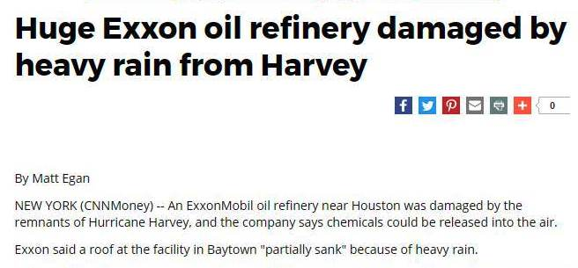
Hurricane Harvey Headlines

Slide 13
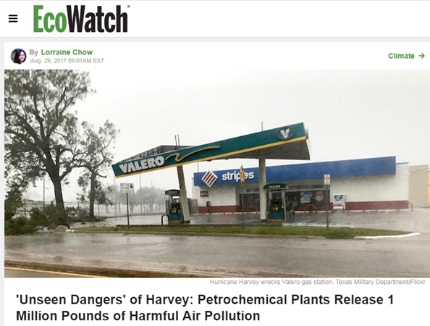
Hurricane Harvey Headlines
Notes:
https://www.ecowatch.com/hurricane-harvey-chemicals-2479091369.html?utm_source=EcoWatch+List&utm_campaign=40ad25449d-EMAIL_CAMPAIGN&utm_medium=email&utm_term=0_49c7d43dc9-40ad25449d-85875141

Slide 14
Notes:
“We have an unprecedented 6 feet of water at the plant,” Arkema President and CEO Rich Rowe said in comments made Wednesday. “We have lost primary power and two sources of emergency backup power.
"As a result, we have lost critical refrigeration of the materials on site that could now explode and cause a subsequent intense fire. The high water and lack of power leave us with no way to prevent it," he added. "We have evacuated our personnel for their own safety. The federal, state and local authorities were contacted a few days ago, and we are working very closely with them to manage this matter. They have ordered the surrounding community to be evacuated, too."
Rowe said there was "no way to prevent" a possible explosion at the plant.
http://abcnews.go.com/US/texas-chemical-plant-braces-explosions-fires-hurricane-harvey/story?id=49521170
Video: http://www.newsweek.com/texas-chemical-plant-explodes-after-hurricane-harvey-657456

Slide 17
ICIS plant status, 9/2/17
Notes:
https://www.icis.com/press-releases/hurricane-harvey-breaking-news-and-latest-developments/?intcmp=Hurricane-Harvey-carousel
None of this is to say that companies could have done much of anything this week to stop the release of these chemicals. Indeed, there is no way to avoid large releases of air pollutants when refineries and chemical plants shut down, and there was no way these companies could have avoided shutting down their facilities faced with such a destructive storm.
The real problem lies in the sheer number of facilities having to shut down or decrease operations at the exact same time—meaning they’ll also all eventually have to start back up. And emissions-wise, starting back up is just as bad as shutting down. That’s evident in the TCEQ emissions reports; rebooting the Formosa Plastics plant two hours outside Houston will be an enormous emissions event. In Corpus Christi, the Flint Hills Resources plant reported releases of 15,000 pounds of sulfur dioxide—a particularly harmful chemical—for its start-up. Most of this, too, is unavoidable, said Neil Carman, the clean air program director at Sierra Club’s Lone Star chapter. “Plants aren’t like cars or trucks where you just push a button and its starts,” he said. “These are huge refineries and petrochemical plants, so it takes a number of hours to heat up their units.”
real problem is that the plants are allowed to operate so close to residential areas in the first place. Houston’s lack of zoning regulations have been front-and-center in discussions about why Harvey has been so terrible for the city, and that’s no different in the discussion about air pollution. “When the city gets back on its feet, it’s a good time to revisit the dialogue about where facilities are allowed to be located, and what precautionary measures can be taken in the future for communities in close proximity to these facilities,” Nelson said. Unfortunately, like so many other problems with Harvey, the discussion may come too late for the most vulnerable.

Slide 18
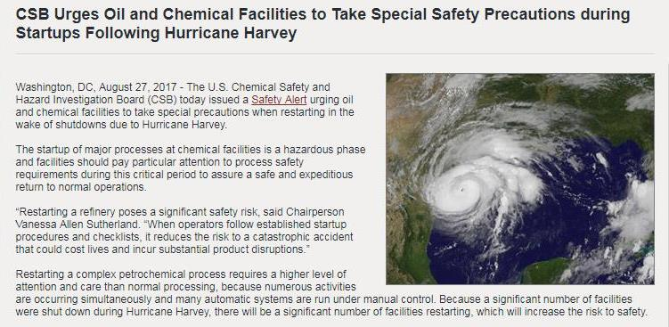
It ain’t over til it’s over

Slide 19
OTA & EPA
Maps & Resources

Slide 20
Mass.gov/eea/ota-climate
Notes:
Go to map and follow directions below:
Look at legend
Talk about Tier II and zoom out (-)
What’s a tier II point?
In 1986, the Emergency Planning and Community Right-to-Know Act (EPCRA) went into effect
Created after horrible insecticide disaster in Bhopal
Goal: help communities prepare for chemical emergencies
Requires industries to report on storage / use / release of haz substances
Requires state / local govts to use info to prepare for risks
3. Let’s look at Tier II in relation to EJ areas. Go to Lawrence and click on area to show how EJ is defined. Then go to Holyoke / New Bedford / Fall River. Then go back to Lawrence.
4. Change basemap to picture
5. De-select EJ in data layers to get clearer pictures
6. Select FEMA flood data sets in data layers. Show all Tier II / toxics near flood zones in Lawrence.
Now let’s talk about Hurricanes – select Hurricanes.
Go to Mulliken Way, Newburyport. Zoom out if you have to (-)
So, if you are a toxics user and are in a hurricane of flood zone, you may want to consider TUR / storage issues / etc.

Slide 21
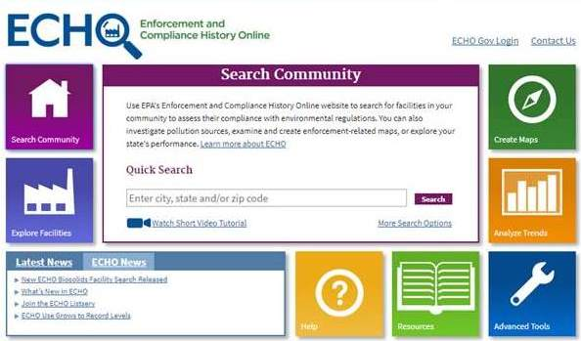
Echo.epa.gov
Notes:
Show different search options
Click on More Search Options
Search facility by sic code:
https://echo.epa.gov/facilities/facility-search?mediaSelected=all​
Attached is an example of SIC 20 - food. If you scroll to the last column on the excel file, there is a link to the full report of the violations.
Search for all violations:
https://echo.epa.gov/facilities/enforcement-case-search/results
Attached is 2010 to present violations. This initially gave me a huge excel file that dated back to the 70's so I cut it back to 2010 to today.
There is a lot more that can be done with this database. If anyone else participated, let me know if you might have time to chat. I'd be curious if you caught some good info that I did not.
Thanks,
Tiffany

Slide 22
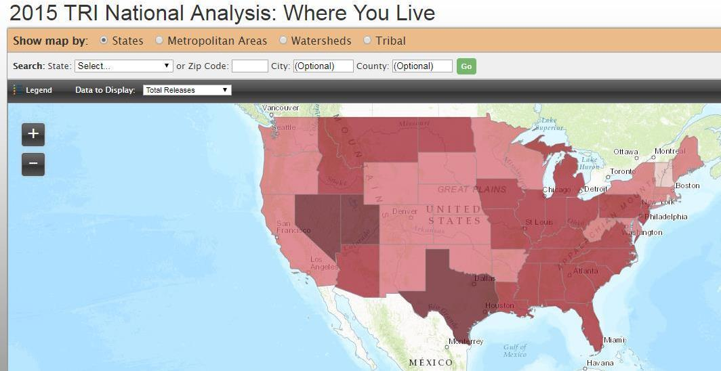
Toxics Release Inventory where you live
https://www.epa.gov/trinationalanalysis/where-you-live-2015-tri-national-analysis

Slide 23
Community Mapping tools
Mass.gov/eea/ota-climate
OTA Ma Toxics Users & Climate Vulnerability
Toxics Release Inventory Where You Live
https://www.epa.gov/trinationalanalysis/where-you-live-2015-tri-national-analysis
Toxics Release Inventory Explorer
https://iaspub.epa.gov/triexplorer/tri_release.chemical
Enforcement & Compliance History Online
https://echo.epa.gov/

Slide 24
Ota services for you
Providing GIS data on toxics users and vulnerable areas
Providing expertise and training on state / federal environmental regulations
Providing expertise and training on toxic chemicals
Ensuring toxics users in your community are in compliance with regulations
Accepting your referrals to toxics users
Engaging businesses in toxics use reduction, safer chemical storage and best practices

Slide 25
Important take aways
Recruit businesses to upcoming trainings:
Refer businesses to OTA (free & confidential!)
www.mass.gov/eea/ota-climate
www.mass.gov/eea/ota

Slide 26
Thank you!
For more Information:
Tiffany Skogstrom
tiffany.skogstrom@state.ma.us, 617-626-1086
@Mass_OTA

