Slide 1
Emergency Planning and Community Right-to-Know (EPCRA) Tier II Reporting

Slide 2
Why do you have to report?
The Massachusetts Statewide Emergency Response Commission (SERC) was established to promote chemical emergency preparedness and prevention through collaboration and planning.
EPCRA requires facilities to maintain material safety data sheets (MSDS) for any hazardous chemical used or stored in the workplace.

Slide 3
Do you have to report?
Tier II Reporting Thresholds:
Extremely Hazardous Substances (EHS)*
500 pounds or threshold planning quantity, whichever is less
All other hazardous substances
10,000 pounds for any material that has an MSDS
* EPA.GOV website for a list of EHS substances

Slide 4
Who do you report to?
Emergency Planning Committee (local or regional)
Local Fire Department
State Emergency Response Commission (SERC)

Slide 5
What format?
Check with your local Fire Department or Emergency Planning Committee
pdf, Tier2.t2s, Zip, Cameo, etc.
Massachusetts is reported through
https://massachusetts.hazconnect.com
File annually with each, usually by March 1st.

Slide 6
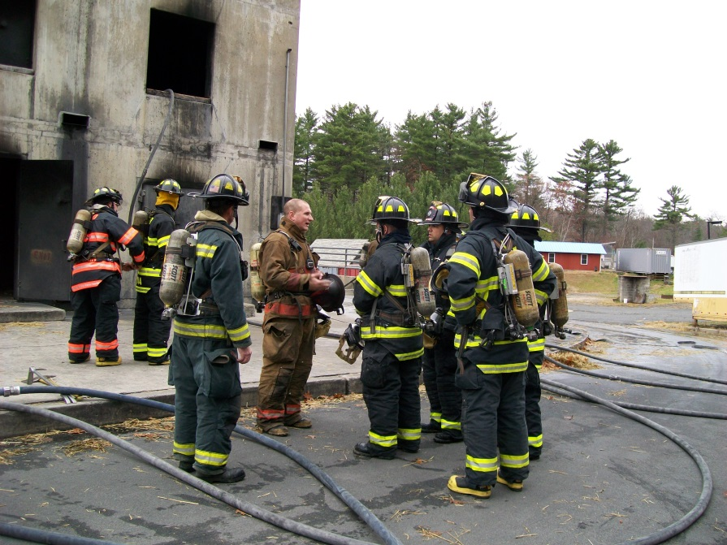
Why do we need MSDS or Tier II?

Slide 7
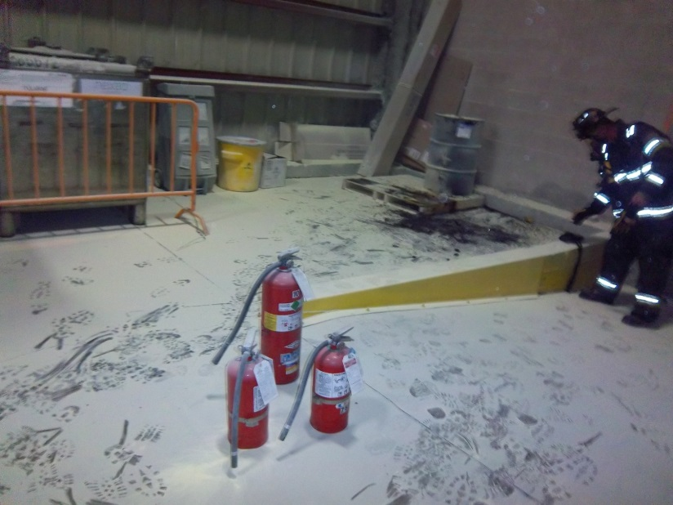
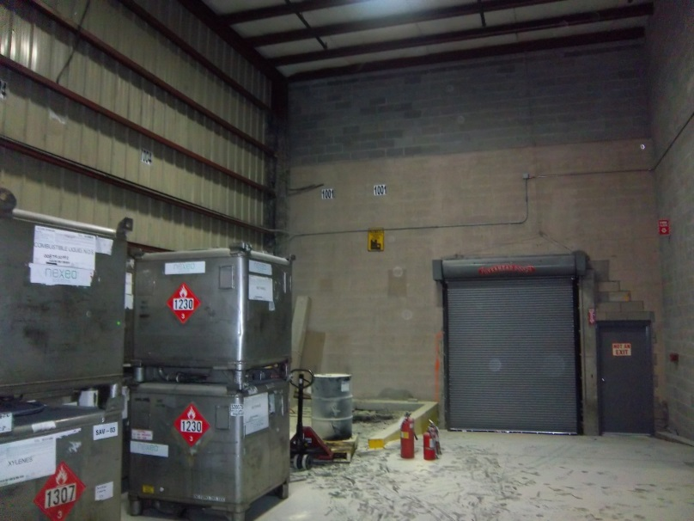
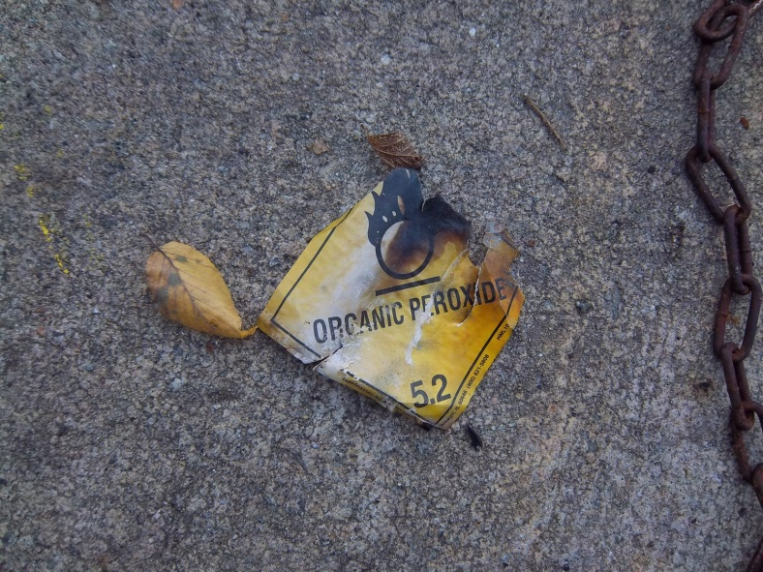
and because this happens….

Slide 8
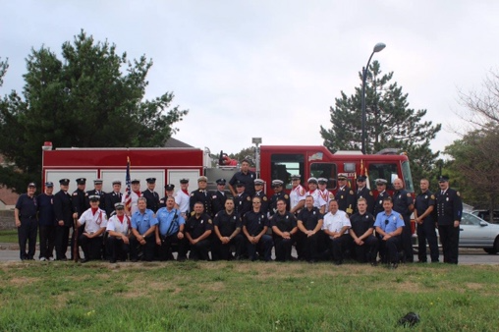
Do they bite?
Not usually…..

