Slide 1
Emergency Planning 101
A Regulatory Review & Tips for Getting Started
Todd Dresser, CHMM, TURP
Todd.Dresser@esis.com
603-921-0913

Slide 2
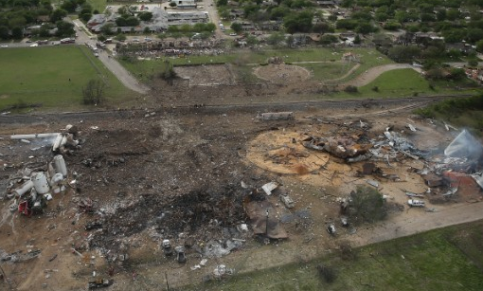
Why are we here?
Fertilizer explosion West, TX- 15 Dead, including 12 firefighters

Slide 3
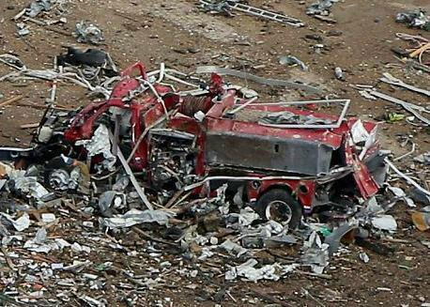
My facility won’t effect anyone else.
West, TX – April 2013

Slide 4
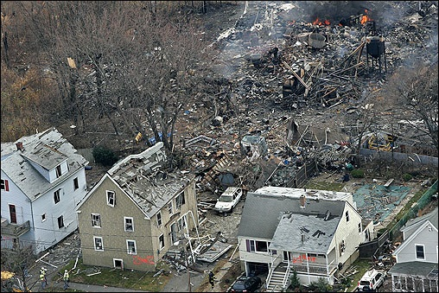
Is this a local concern?
Danvers, MA

Slide 5
What are the Requirements?
EPCRA & SARA Title III
RCRA
Oil Pollution Prevention Act (SPCC)
CFATS – Chemical Facility Anti-Terrorism Standard
CAA – Risk Management Program
OSHA – Process Safety Management Standard*
MA Hazardous Materials Processing* Regulation

Slide 6
EPCRA – Emergency Planning & Community Right to Know
Requires facilities storing materials in excess of Threshold Planning Quantities (TPQs) – typically 10,000 lbs to file annual Tier II with local emergency responders.
Lower TPQs (e.g. 100 to 500 lbs) for extremely hazardous substances (EHSs – chlorine, AA, HF)
EHS facilities must work with LEPC & FD to develop emergency response plan.
Tier II filers are expected to support and participate in LEPC/REPC.
Provides broad authority to LEPC/FD to request information to support local planning effort.

Slide 7
RCRA – Resource Conservation & Recovery Act
LQGs are required to develop a Contingency Plan and share it with local emergency responders.
LQGs are now required to work with local responders to develop a site pre-plan.
SQGs are encouraged to develop a Contingency Plan and share it with emergency responders.

Slide 8
Oil Pollution Prevention Act
Facilities that store more than 1320 gallons of petroleum on site are required to develop a Spill Control & Countermeasures Plan (SPCC Plan).
Regulated sites must initiate control measures to prevent the release of petroleum.
Site must identify and train response staff.
Site must identify off site resources to provide spill response when needed.
Site is required to conduct monthly inspections.

Slide 9
Chemical Facility Anti-Terrorism Standard
Facilities storing specific materials above planning threshold are required to report and screen their facility for risk using Homeland Security protocol.
Facilities deemed a risk may have to complete more in depth screening or may be inspected by Homeland Security.
Sample materials of concern: anhydrous ammonia, chlorine, propane

Slide 10
Clean Air Act – Risk Management Program
Facilities that store respiratory toxins (e.g. chlorine or anhydrous ammonia) above planning thresholds must prepare RMP plan.
RMP plan will include a comprehensive review of the facility, identify control or mitigation measures, requires the preparation of a worst case and realistic release scenario.
These facilities can pose major risks that can impact square miles.

Slide 11
OSHA – Process Safety Management Standard
Facilities that store or use specific flammable or toxic materials on site usually in excess of 10,000 lbs are required to develop a PSM plan.
The standard requires the facility to conduct a comprehensive hazard analysis and to initiate control measures to mitigate the risk posed by site operations.
These facilities can pose a major hazard.
These sites should actively coordinate with local responders to develop a training and response plan.

Slide 12
MA Hazardous Materials Processing Standard
Most businesses using hazardous materials are now required to provide process information to local responders & obtain a permit from the FD.
This standard applies OSHA PSM type requirements on facilities that have tanks/containers with a volume of 300 gallons.
Grants broad authority to FD to seek information for planning purposes.
Requires facilities to work with FD to develop an emergency response plan.

Slide 13
Leveraging Regulations to Collect Information
Create review checklist for use during site plan or permit review process.
Ask applicant if any of these requirements apply to their operation. Require a written response.
Hint: Also ask for a copy of their chemical inventory to compare.
Require applicants to provide copy of their response plans and to work with responders to develop pre-plan.
Remember state & federal agencies will help if sites are unresponsive.

Slide 14
The Following Municipal Facilities Are Often Subject to these Regulations
Highway Garage
Drinking Water Plants
Wastewater Plants
Ice Rinks
Municipal Pools
Motor pool/fleet operations
Grounds/field maintenance
Airports
Port Authorities

Slide 15
Goals for Pre-planning
Identify & address historic problem areas.
Identify & plan for likely scenarios.
Collect & organize the info you would need if these events occur.

Slide 16
Things to Consider
Process or system upset
Structural failure
Transportation release
Problems caused by loss of power or water
External impacts
Potential for run away reactions
Weather induced problems
Issues causing greater concern during a fire

Slide 17
Use the 80/20 Scale
Focus on what you can manage.
Work through scenarios for 3 most likely problems.
Inspect, maintain, repair or upgrade your equipment.
Develop procedures and train staff to support effort.
Review, practice and update procedures.
Drills help alleviate the mental fog that can occur in a crisis.

Slide 18
Coordinating with Emergency Responders
Invite the fire dept. to tour your facility.
Share your Contingency Plan.
Make the most of your Knox box.
Create a Pre-plan
Review high hazard/critical processes or storage areas.
Label and photograph these areas.
Do you need specialized medical support
Cyanides, Hydrofluoric acid or others?
Consider a drill.

Slide 19
Prepare a Pre-Plan
Identify critical do’s & don'ts's
Establish incident command and notification procedures.
Identify safety controls to be maintained.
Plan for 3 likely potential problems.
Identify potential external impacts - develop notification or response procedures for these receptors.
Train staff
Review plan with emergency responders.

Slide 20
Sample Pre-Plan

Slide 21
Critical Questions

Slide 22
Process Descriptions & Scenarios

Slide 23
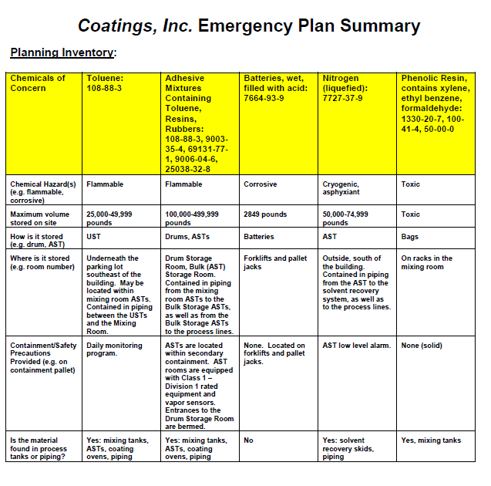
Materials of Concern

Slide 24
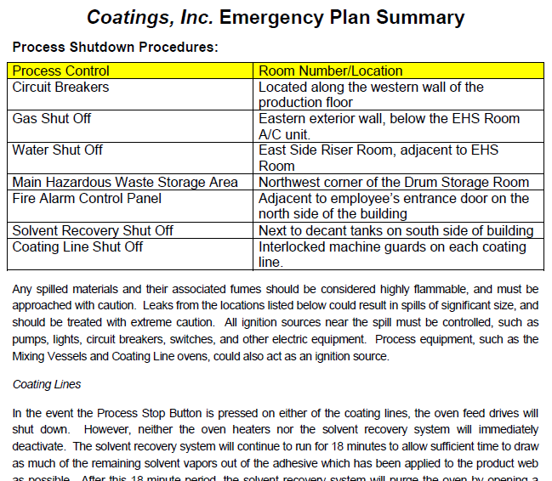
Shutdown Procedures
Insert photos of the process controls and storage containers into the plan to assist responders.

Slide 25
Potential Offsite Impacts

Slide 26
Locus Map for Reference

Slide 27
Plant Schematic

Slide 28
Critical Chemical Info

Slide 29
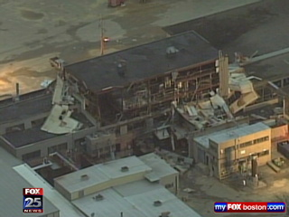
Insert Your Logo Here????

Slide 30
Questions??
Todd Dresser, CHMM, TURP
Todd.Dresser@ esis.com
603-921-0913
https://www.linkedin.com/todddresser

